Slide 1

MEDIGITZ
your child’s health companion
Developed by,
EXCEPTION HANDLERS

Slide 2
Each year 2.1 million children are undervaccinated.
They are at increased risk of life threatening diseases
PROBLEM STATEMENTS WE CONSIDERED….
Many parents are unaware about the vaccination that must be given to kids at regular intervals.This ignorance can even cost the life of innocent kids
Unhealthy food styles of children are making them vulnerable to many lifestyle diseases
Many children are now facing obesity and undergrowth. This is due to not tracking growth rate according to child’s age
Young parents are generally confused and worried about parenting. If there is no one to guide them, it will affect the overall development of their child.

Slide 3
WE
OFFER
SINGLE SOLUTION
FOR ALL THESE
- MEDIGITZ

Slide 4
LINK TO OUR PROTOTYPE VIDEO
https://drive.google.com/file/d/1jfU7cCAZRWTtZwUQdU-QdHGYeXqVxnNC/view?usp=sharing

Slide 5
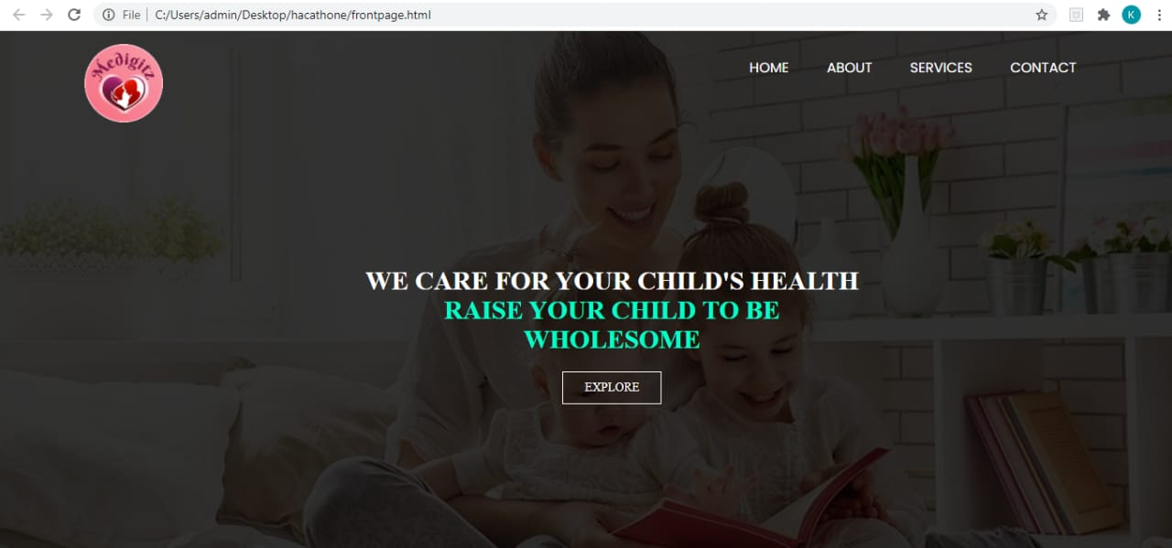

Slide 6


MEDIGITZ ENSURES IMMUNISATION ,MAKING KIDS HEALTHY
Ensure child’s physical health by providing vaccination at right time
HHHHH

Slide 7
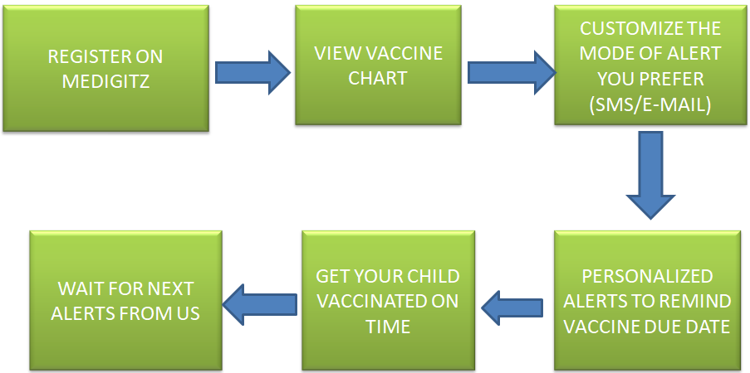
HOW IT WORKS?

Slide 8
SAY NO TO MALNUTRITION AND UNHEALTHY FOOD ROUTINE WITH MEDIGITZ

Slide 9
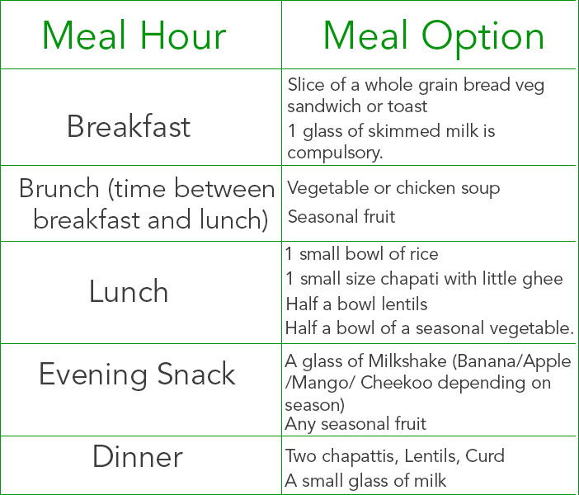
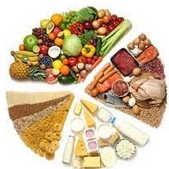
WE PROVIDE AGE WISE DIET CHART RECOMMENDATIONS

Slide 10
GROWTH TRACKER
Helps to identify your kid’s health status- underweight,overweight or normal weight
Height
WE WILL PROVIDE REPORTS AND PERSONALIZED RECOMMENDATIONS
BMI CALCULATOR
Assess
Weight

Slide 11
CHATBOT FACILITY FOR CONSULTATION APPOINTMENT BOOKING
PROVIDES A PLATFORM TO COMMUNICATE YOUR WORRIES/DOUBTS AND WE WILL PROVIDE EFFICIENT SOLUTIONS

Slide 12
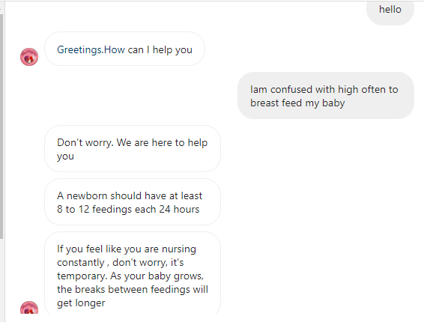
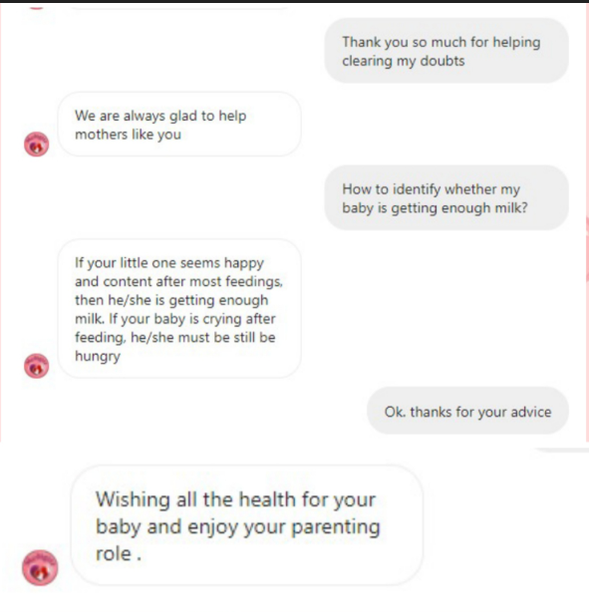
CHATBOT SAMPLE

Slide 13
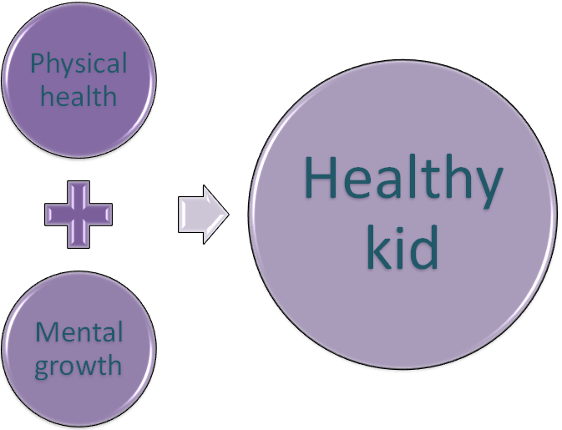
We believe that health not only depends on physical fitness, but also in mental growth

Slide 14

ADD-ON FEATURE
Infant learning simplified
We are providing elementary learning materials to kids to accelerate their learning at an early stage.

Slide 15
SERVICES MEDIGITZ OFFER
Get your child vaccinated on time
Book a consultation appointment
Your kid’s personalized nutrition chart
Inspect your child’s health
Get advice for efficient parenting through chatbot facilities
Pave new ways to your child’s learning

Slide 16
LINK TO OUR PROTOTYPE VIDEO
https://drive.google.com/file/d/1jfU7cCAZRWTtZwUQdU-QdHGYeXqVxnNC/view?usp=sharing

Slide 17
THANK YOU

